Slide 1
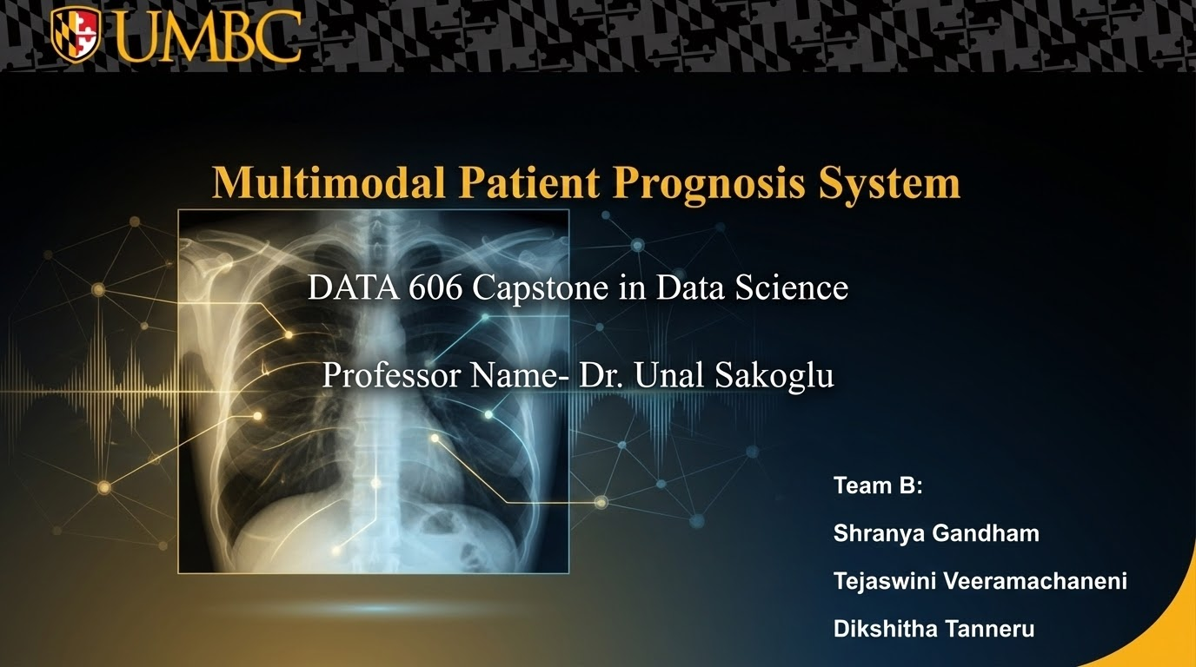

Slide 2
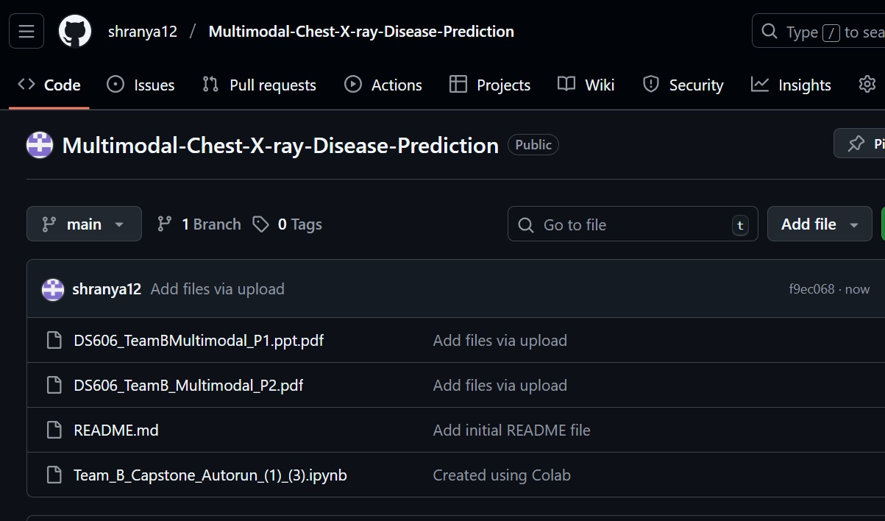
Github Link:
https://github.com/shranya12/Multimodal-Chest-X-ray-Disease-Prediction

Slide 3
Project Overview
Developed a multimodal deep learning system combining Chest X-rays, EHR metadata, and text proxies for disease and severity prediction.
Used the NIH ChestX-ray14 dataset (112K+ images, 15 diseases) for multi-label classification. We have taken a sample of 4999 images from the whole dataset.
Implemented and compared state-of-the-art models: DenseNet121, ResNet-50, EfficientNet-B0, and ViT-B16.
Evaluated model performance using AUROC, Average Precision, ROC/PR curves, and disease-wise metrics.
Added Grad-CAM explainability and a custom severity scoring system using disease probabilities + age/gender.
Built a single-image inference tool with severity output, heatmaps, and an optional simulated ICU outcome predictor.

Slide 4
Problem Statement
Chest X-ray interpretation is challenging due to overlapping anatomical structures and subtle disease patterns.
Radiologist availability is limited, leading to delays in diagnosis and clinical decision-making.
Multi-label classification of thoracic diseases is difficult because many conditions appear simultaneously.
Severity assessment is subjective and varies across clinicians, reducing consistency in patient triage.
Traditional models rely only on imaging and ignore valuable patient metadata such as age and gender.
Hospitals lack an integrated tool that combines imaging, clinical data, and explainability for outcome prediction.

Slide 5
Dataset Description
Problem Type : Multi-label Classification
Dataset link: https://www.kaggle.com/datasets/nih-chest-xrays/data
Size of subset: 4999 images (Train 2756 | Val 689)
Total images: 112,120
Patients: 30,805
Features/Attributes:
•X-ray image (pixel arrays)
•Age, Gender, View Position (EHR)
•Text notes(csv file) / disease label
Image Resolution Preprocessing: Resized 224×224
Target Variable: 15 binary disease columns (Atelectasis, Cardiomegaly, Effusion, Infiltration, Mass, Nodule, Pneumonia, Pneumothorax, Consolidation, Edema, Emphysema, Fibrosis, Pleural Thickening, Hernia, No Finding)

Slide 6
Literature Review
Benchmark studies on NIH ChestXray14 using CheXNet (DenseNet121), EfficientNet, and Vision Transformers (ViT) show
AUROC 0.70–0.77 with unimodal image-only models.
These models perform well visually but lack clinical context, limiting performance on ambiguous or overlapping pathologies.
Our work advances this by using multimodal fusion for richer diagnostic representation.
We place strong emphasis on explainability, implementing class-wise Grad-CAM and severity outcomes for interpretable model insights.
Ongoing enhancements include:
Fine-tuning fusion weights & training parameters
Refining gradient normalization for better interpretability
Strengthening documentation & maintaining a reproducible Git workflow

Slide 7
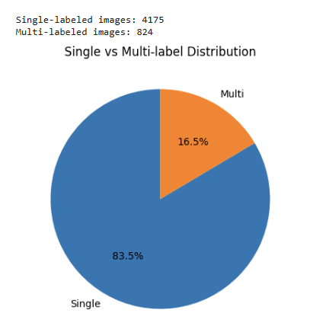
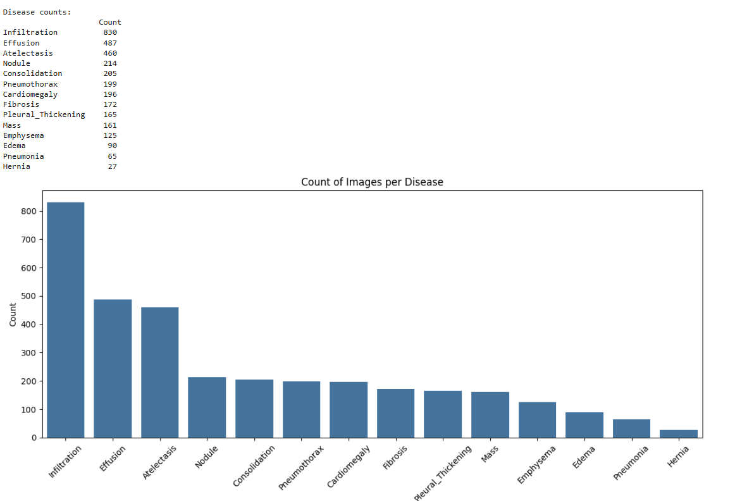
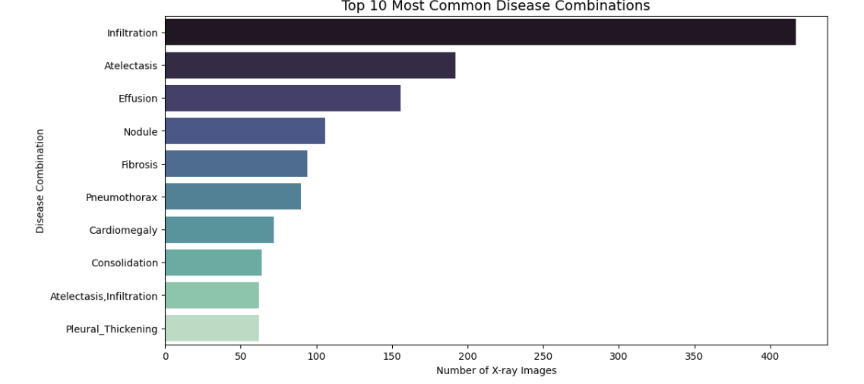
Data Exploration

Slide 8
Methodologies
Model Architecture: DenseNet121 (ImageNet pretrained) for Chest X-ray feature extraction Tabular + Text Head (MLP): (Tab + Text) → 512 → 256 with ReLU + Dropout Final Fusion:(1024 Image + 256 Tab/Text) → 512 → 15 disease outputs
Training Setup
Loss Function: Binary Cross-Entropy with Logits (BCE With Logits Loss)
Optimizer: AdamW
Multi-label classification across 15 thoracic diseases
Evaluation Strategy
Metrics: Mean AUROC & Mean Average Precision (AP)
Best model saved using validation AUROC
Training Loop
Forward pass → Loss → Backpropagation → Weight update
Validation after each epoch
Automatic best model checkpointing

Slide 9
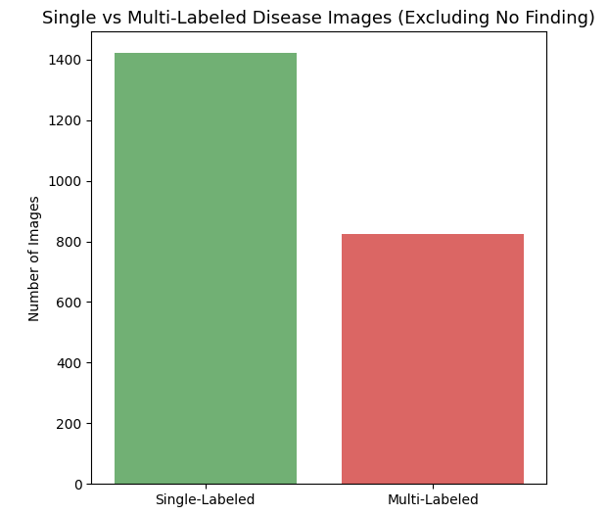
Preprocessing Pipeline
Image Processing Resized to 224×224 - normalized with ImageNet stats, and applied light augmentation horizontal flip
Tabular Feature
Extracts EHR features (age, gender, image size, etc.)
Uses One-Hot Encoding for gender and X-ray view type (PA/AP).
Standardizes numerical features.
Converts clinical notes (notes_text) into numeric vectors using TF-IDF (text feature extraction)
Text Modality
Simulated text embeddings used as a placeholder for future clinical notes
Enables true multimodal fusion design
Fast-Load Setup Saved preprocessed arrays and enabled cached loading for quick train/val dataset creation.

Slide 10
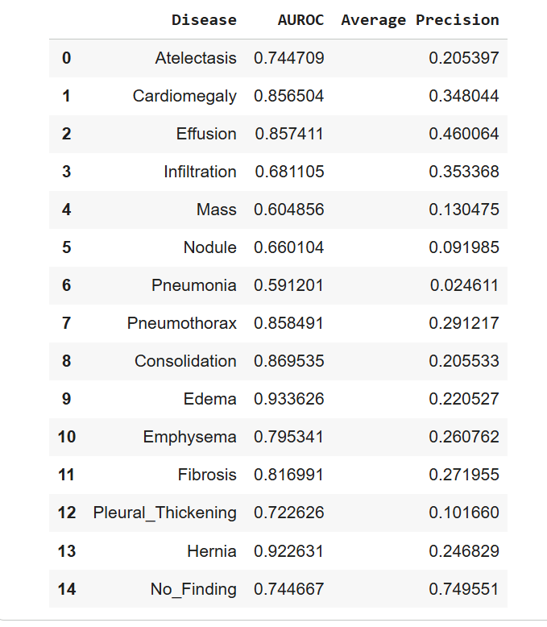
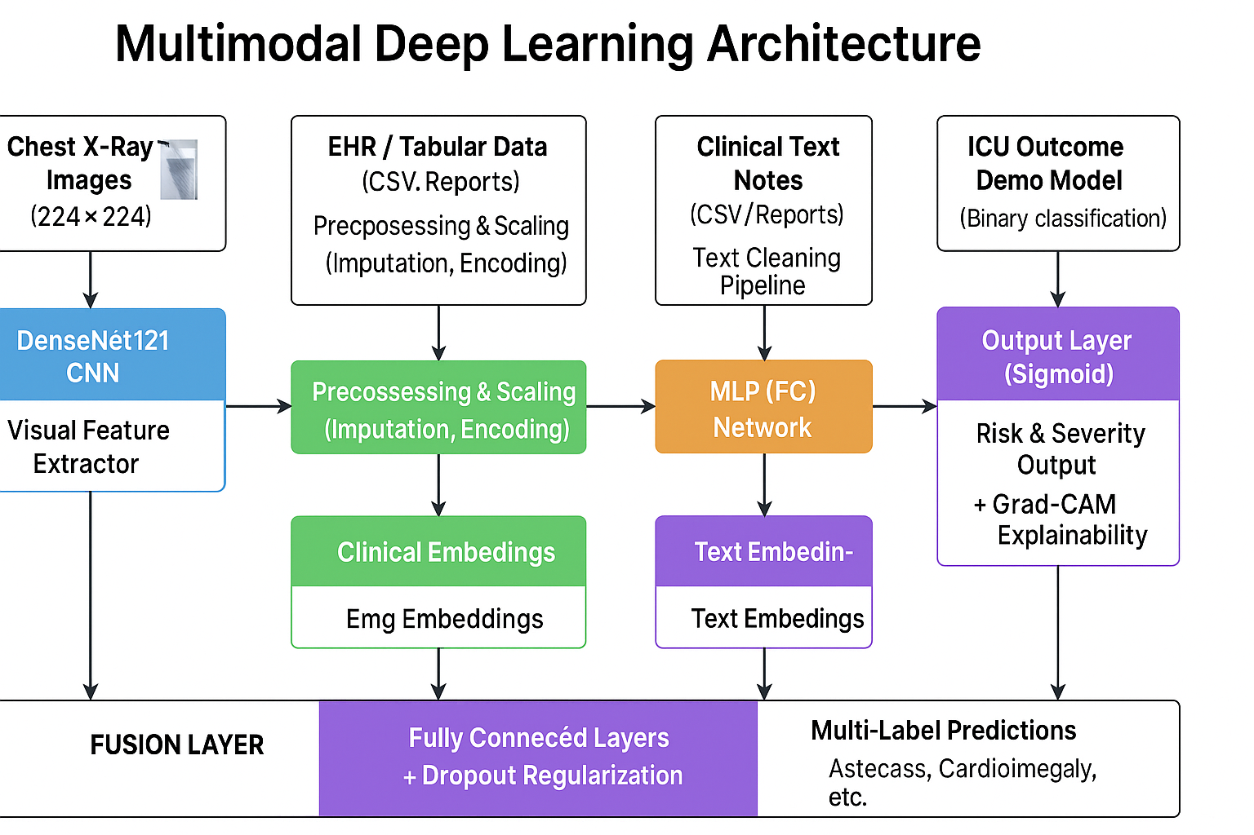
Model Architectures Evaluated
DenseNet121 CNN with dense connections for strong feature reuse; highest performance in our tests.
ResNet50 Residual CNN architecture : stable, efficient, and well-suited for multimodal fusion.
EfficientNet-B0 Lightweight model optimized for accuracy vs. speed; good baseline performance.
ViT-B16 (Vision Transformer) Transformer-based image model; requires larger datasets, resulting in lower performance on our subset.
Why Evaluate Multiple Models? To compare feature extraction quality across CNNs and Transformers and select the best architecture for multimodal integration.

Slide 11
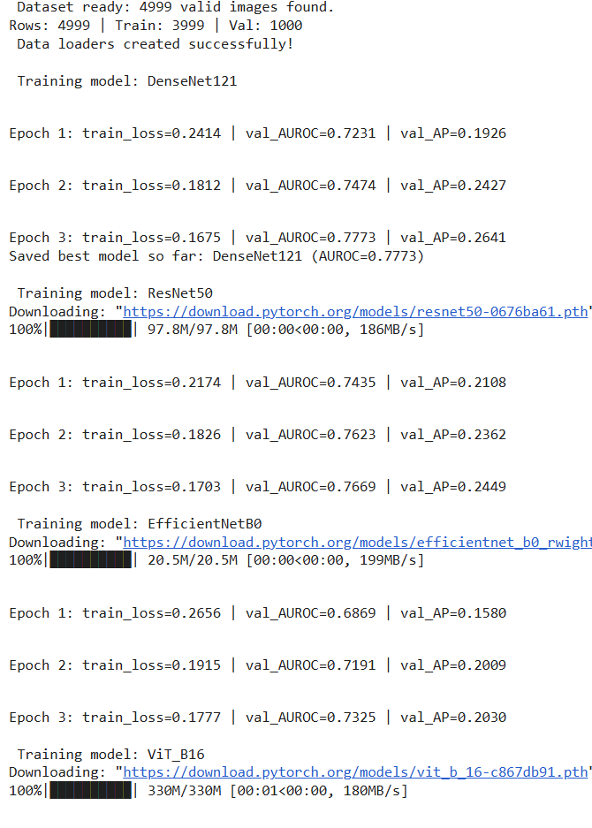
Training Performance
Model training monitored using epoch-wise AUROC curves.
Training AUROC steadily improved across epochs, showing good learning progression.
Validation AUROC remained stable, indicating limited overfitting.
Learning rate scheduling and early stopping helped optimize convergence.
Performance trends validated that the chosen architecture and preprocessing pipeline were effective.

Slide 12
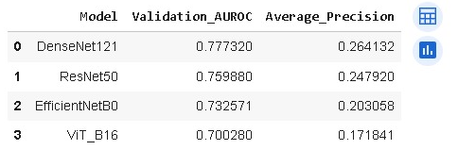
Model Comparison
DenseNet121 achieved the best overall performance
Highest AUROC: 0.777 Highest Average Precision: 0.264
ResNet50 ranked second with strong, stable performance → AUROC: 0.759, AP: 0.248
EfficientNet-B0 offered good accuracy but lower AP → AUROC: 0.732, AP: 0.203
ViT-B16 underperformed on this dataset subset → AUROC: 0.700, AP: 0.172
Conclusion: DenseNet121 is the top-performing model, while ResNet50 is the best trade-off for multimodal fusion (speed + accuracy).

Slide 13
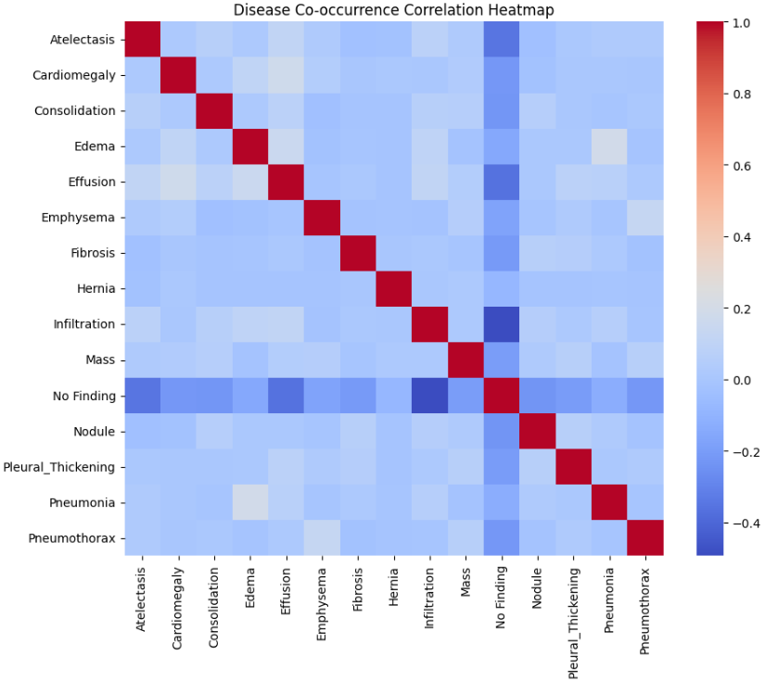
Disease Co-occurrence Correlation Heatmap
Visual representation of how often different chest pathologies appear together.
Diagonal shows perfect correlation for each disease with itself.
Lighter colors indicate stronger positive correlations between disease pairs.
Darker blue tones reflect negative or weak correlations.
Helps identify clinically relevant relationships that may influence diagnosis or model predictions.

Slide 14
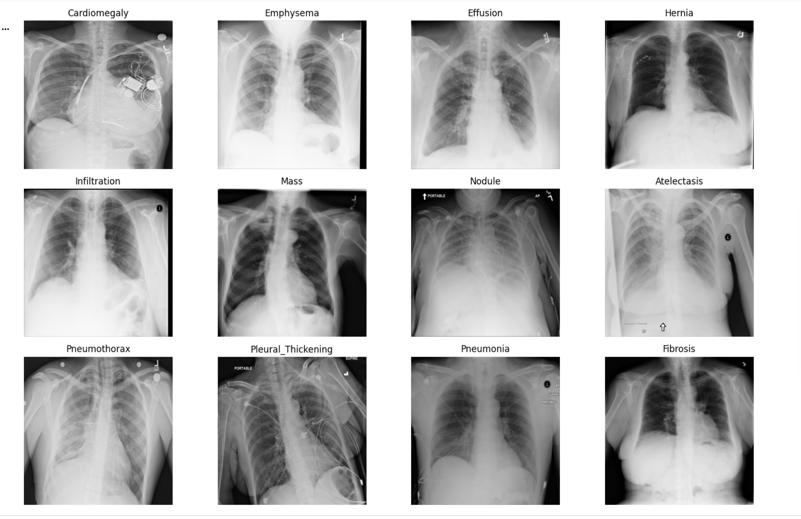
Sample X-rays: One Image per Disease Category

Slide 15
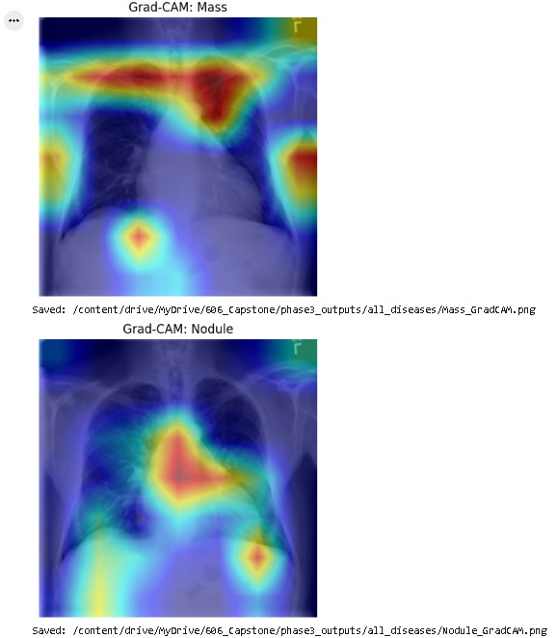
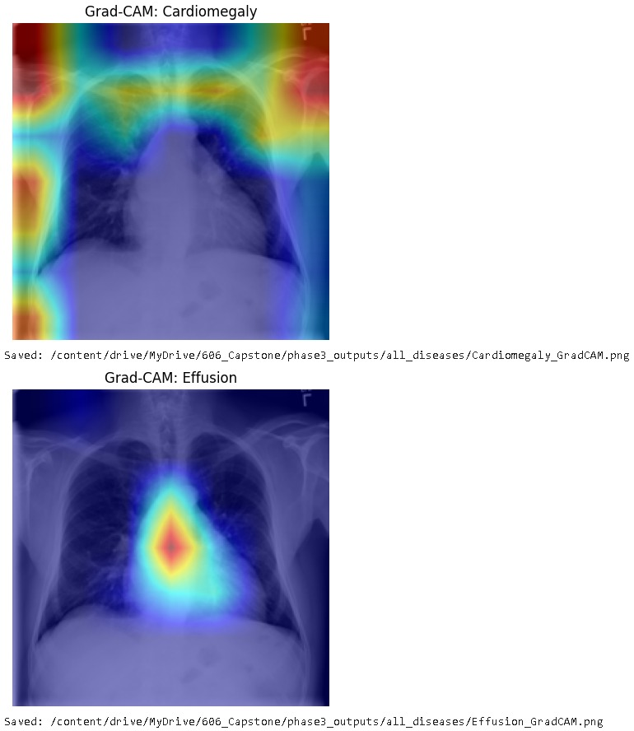
Grad-CAM
Heatmaps show where the model focuses inside the X-ray for each predicted disease.
Red/yellow areas represent the strongest attention influencing the prediction.
For Effusion and Cardiomegaly, activations appear around pleural spaces and the heart border—clinically correct regions.
Mass and Nodule show small, localized hot spots, indicating detection of subtle abnormalities.
These patterns confirm that the model focuses on meaningful anatomy rather than guessing, increasing trust in its predictions. .

Slide 16
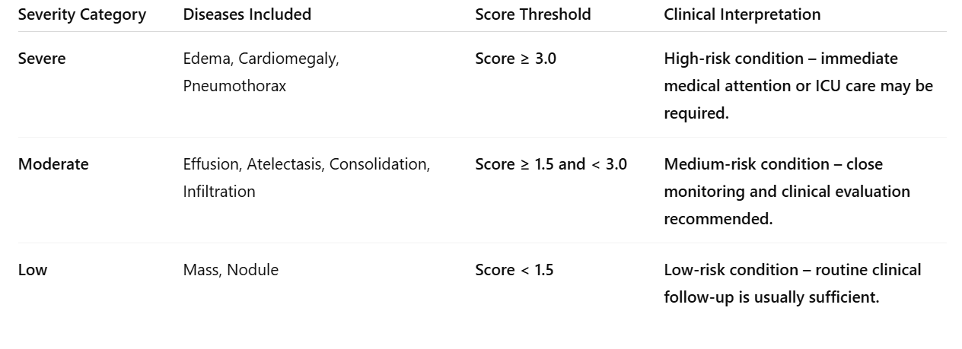
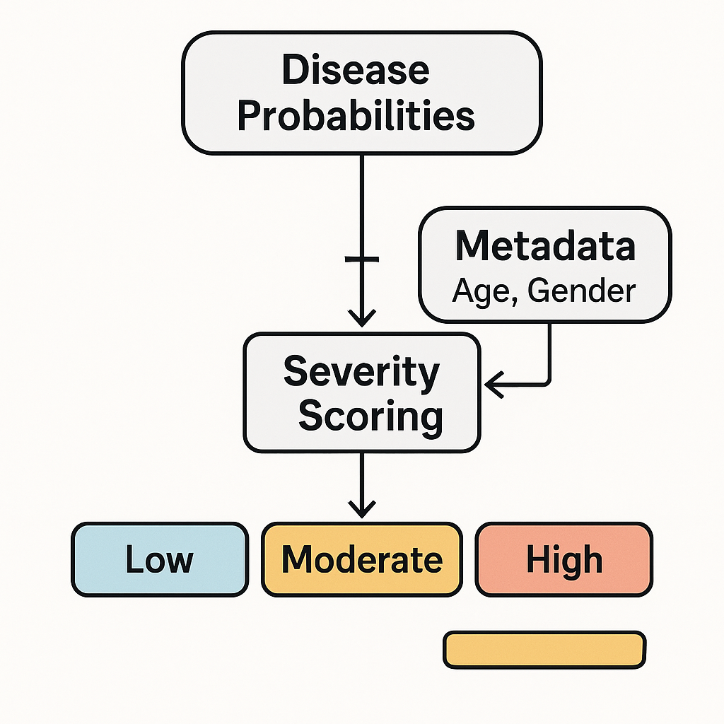
Severity Scoring System
What is Severity Scoring system?

Slide 17
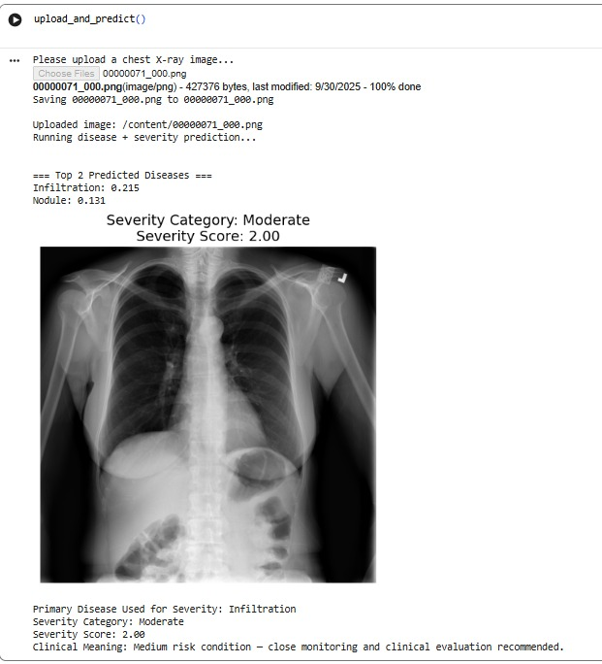
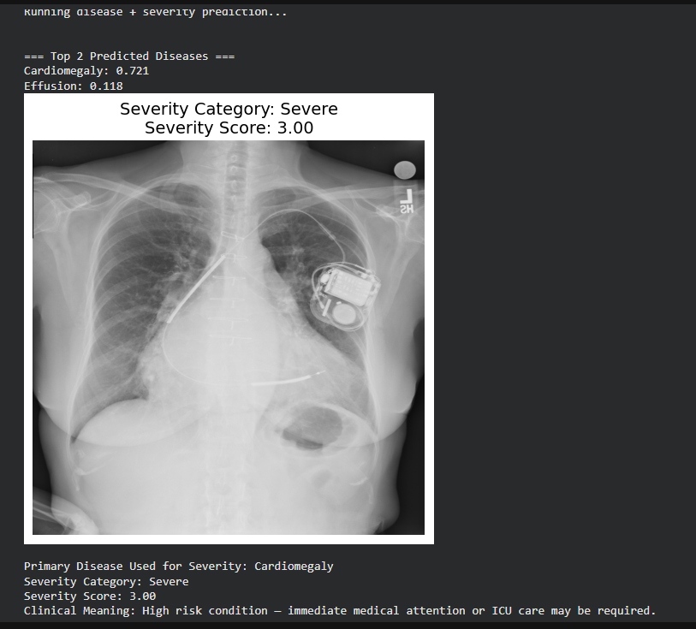
Demo

Slide 18
Conclusion
Developed a complete end-to-end multimodal deep learning system for chest X-ray disease detection and severity assessment
Implemented a DenseNet121-based multi-label classifier with strong performance validated using AUROC and Average Precision
Used ROC and Precision–Recall curves for comprehensive model evaluation.
Integrated Grad-CAM explainability to visualize clinically relevant regions and improve model transparency
Designed a real-time severity scoring and risk classification system for clinical triage support
Enabled manual X-ray upload, automated disease prediction, severity assessment, and visual explanations
Demonstrated the system’s potential for clinical decision support and future ICU outcome prediction

Slide 19

Future Work
Train on the full 112K NIH dataset to improve model accuracy.
Upgrade to transformer-based multimodal models (ViT + Tab Transformer).
Apply better class imbalance handling (focal loss, oversampling).
Add more explainability methods (Integrated Gradients, SHAP).
Deploy as a web-based clinical tool for real-time predictions.
Expand the ICU outcome prediction module using richer metadata.

Slide 20
References
Wang, X., Peng, Y., Lu, L., Lu, Z., Bagheri, M., & Summers, R. M. (2017). ChestX-Ray8: Hospital-Scale Chest X-Ray Database and Benchmarks on Weakly-Supervised Classification and Localization of Common Thorax Diseases. 2017 IEEE Conference on Computer Vision and Pattern Recognition (CVPR). https://doi.org/10.1109/cvpr.2017.369‌
Rajpurkar, P., Irvin, J., Zhu, K., Yang, B., Mehta, H., Duan, T., Ding, D., Bagul, A., Langlotz, C., Shpanskaya, K., Lungren, M. P., & Ng, A. Y. (2017). CheXNet: Radiologist-Level Pneumonia Detection on Chest X-Rays with Deep Learning. ArXiv.org. https://arxiv.org/abs/1711.05225‌
Irvin, J., Rajpurkar, P., Ko, M., Yu, Y., Ciurea-Ilcus, S., Chute, C., Marklund, H., Haghgoo, B., Ball, R., Shpanskaya, K., Seekins, J., Mong, D. A., Halabi, S. S., Sandberg, J. K., Jones, R., Larson, D. B., Langlotz, C. P., Patel, B. N., Lungren, M. P., & Ng, A. Y. (2019). CheXpert: A Large Chest Radiograph Dataset with Uncertainty Labels and Expert Comparison. Proceedings of the AAAI Conference on Artificial Intelligence, 33, 590–597. https://doi.org/10.1609/aaai.v33i01.3301590

Slide 21

Any questions?

